Slide 1

What is CalAIM?
Stands for “California Advancing and Innovating Medi-Cal” (CalAIM)
Five year (2022-2027) statewide plan under Medi-Cal to streamline and improve delivery of services through managed care.
Major Changes for Aging Adults with CalAIM:
Transition to managed care for 31 counties including people in Skilled Nursing Facilities
14 optional community supports added in most counties to specific high risk populations
Enhanced Care Management (ECM) for high risk populations
Notes:
Pauline

Slide 2
What if the Managed Care Plan Does Not Cover the desired Community Support?
Most plans will offer all supports by 2027, contact the plan to see if they are able to provide comparable services or how soon they plan to implement the desired support.
  DHCS List of Community Supports by County and Managed Care Plan: https://www.dhcs.ca.gov/Documents/MCQMD/Community-Supports-Elections-by-MCP-and-County.pdf
  CANHR’s Community Supports Resources by County List: https://docs.google.com/spreadsheets/d/17xjvj4lBlu7h-owY1yxqsOb3a5i07xIfJsYYmhpbYM8/edit?usp=sharing
If the desired support is not available consider switching to a plan that offers the support you need.
Explore if any HCBS Medi-Cal waiver programs can meet your needs. See CANHR’s HCBS Quick Guide.
Notes:
Pauline

Slide 3
Enhanced Care Management (ECM) and Community Supports Overview
41144

Slide 4
Enhanced Care Management (ECM)
Notes:
Gillian

Slide 5
Enhanced Care Management
Definition
Purpose
Build on the design and learning from Whole Person Care (WPC) pilot and the Health Homes Program (HHP)
ECM with Community Supports replaces WPC and HHP
Scales up the interventions to form a statewide care management approach
Targets high-need, high-cost Medi-Cal managed care members
Transition WPC and HHP members into ECM and/or ILOS
Enhanced Care Management (ECM) is a collaborative and interdisciplinary approach to providing intensive and comprehensive care management services to targeted individuals.
Goals of ECM:
Improve care coordination
Integrate services
Facilitate community resources
Improve health outcomes
Decrease inappropriate utilization and duplication of services

Slide 6
ECM Populations of Focus (POFs)
Enhanced Care Management (ECM)
Populations of Focus (POFs)
Adults living in the community who are at risk for Long-Term-Care (LTC) institutionalization (January 1, 2023)
Adults living in the community who meet the SNF level of care or require lower acuity skilled nursing AND
Are actively experiencing at least one complex social and environmental factor influencing the health AND
Are able to reside continuously in the community with wraparound supports
Notes:
Note that we have more POFs, we’re just highlighting these for now.

Slide 7
Overview of ECM
Seven Core Services
Comprehensive Assessment and Care Management Plan
Enhanced Coordination of Care
Health Promotion
Comprehensive Transitional Care
Member and Family Supports
Coordination of and Referral to Community and Social Support Services
Outreach and Engagement
Notes:
Outreach and Engagement: members are contacted by their assigned ECM provider in a cadence that aligns with their acuity level (set by SCFHP) for an ongoing 12-month period to enroll them into ECM
Comprehensive Assessment and Care Management Plan: a comprehensive assessment is conducted and a care plan is developed within 90 days of enrollment into ECM
Enhanced Care Coordination of Care: involves necessary services that assists members with achieving their care plan goals.
Health Promotion: involves encouraging and supporting members enrolled in ECM in making lifestyle choices based on healthy behavior, with the goal of motivating them to successfully monitor and manage their own health
Comprehensive Transitional Care: provides support to members and their supportive networks during discharge from a hospital or institutional setting
Member and Family Supports: engage members and their supportive networks in care plan development and monitoring, and ensure all are knowledgeable of members’ conditions
Coordination of and Referral to Community and Social Support Services: determine appropriate services to meet members’ needs to ensure that any present or emerging social factors are identified and addressed

Slide 8
ECM Contracted Providers
Adults Only
Avenidas
Children/Youth Only
Full Circle Health Network (hub)
Both
Asian American in Community Involvement*
Bay Area Community Health*
Valley Medical Center and Clinics*
Indian Health Center of Santa Clara County*
Institute on Aging
Master Care Plan
Mayview/Ravenswood Clinic*
Peninsula Healthcare Connections-New Direction
Oversight MD
Silicon Valley Independent Living Center
Sourcewise
Hope Services
Gardner Family Health Network*
Healthier Kids Foundation
North East Medical Services*
Pacific Clinics
Pacific Health Group
Roots Community Health Center
School Health Clinic
Serene Health
Titanium Healthcare
Seneca Family of Agencies
Access Care Management
Star Nursing
VyncaCare
Hub: Holds the ECM contract with the health plan but does not provide direct services. Hub will contract-out services to other entities in the community
* May accept populations outside of their ECM focus, if member is assigned to the provider for primary care services

Slide 9
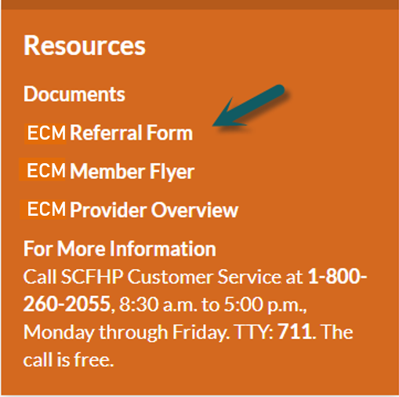
ECM Referral Process
Referring entities can access the SCFHP ECM Referral Form on SCFHP’s website at www.scfhp.com/ecm.
A referring entity must complete a referral form and submit it with the required documentation to SCFHP via secured email to ECM@scfhp.com or by fax to
408-874-1469.
SCFHP reviews referrals and accompanying documentation, determines if member is eligible for ECM; and if eligible, assigns the member to a contracted ECM provider. This process takes 3 – 5 business days once SCFHP receives the member’s medical records.
SCFHP sends an eligibility letter to the member with general information on ECM and the name and contact information of their assigned ECM provider.
SCFHP sends an email to the assigned ECM provider notifying them of the assignment and places the member on the subsequent eligibility file. The ECM provider begins outreach and engagement activities shortly after assignment.
*For referring entities that are conducting business in a language other than English, it is best for them to call SCFHP’s Customer Service at 1-800-260-2055 (TTY: 711).
ECM providers, primary care physicians (PCPs), specialists, Community Supports providers, community-based organizations, members, authorized representatives, and supportive individuals can submit a referral form to SCFHP for ECM services.

Slide 10
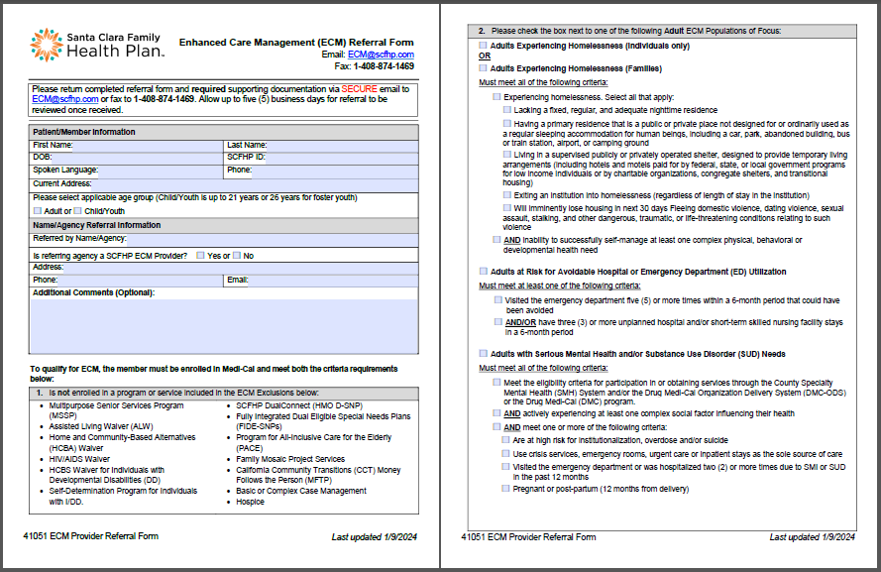
ECM Referral Form

Slide 11
Community Supports
Notes:
Gillian

Slide 12
Community Supports 2
Definition:
Medically-appropriate and cost-effective alternatives to services that can be covered under Medi-Cal that are typically delivered by different providers and/or in different settings than traditional Medi-Cal services. These services do not replace benefits that you already get under Medi-Cal, are optional for members, and may be available under an Individualized Care Plan.
Goal:
Build upon success of the Whole Person Care (WPC) and Health Homes Program (HHP) pilots by focusing on combined medical and social determinants of health to avoid high levels of care:
  Hospital or nursing facility admissions
  Discharge delays
  Emergency Department use
Purpose:
Establish a foundation for implementing community-based services into the managed care Long Term Supports & Services (LTSS) model.
Complementary to ECM, although members do not need to be enrolled in ECM to be eligible.
Not a benefit, this is a pre-approved optional services that health plans choose to offer members

Slide 13
Community Supports 3
Community Supports
Community Support | Launch Date
Housing Transition Navigation Services | 1/1/2022
Housing Deposits | 1/1/2022
Nursing Facility Transition/Diversion to Assisted Living Facilities, such as Residential Care Facilities for Elderly and Adult Residential Facilities | 1/1/2022
Community Transition Services/Nursing Facility Transition to a Home | 1/1/2022
Medically Supportive Food/Meals/Medically Tailored Meals | 1/1/2022
Housing Tenancy and Sustaining Services | 7/1/2022
Recuperative Care (Medical Respite) | 7/1/2022
Sobering Center | 7/1/2022
Personal Care and Homemaker Services | 1/1/2023
Respite Services | 1/1/2023
Environmental Accessibility Adaptations (Home Modifications) | 1/1/2023
Asthma Remediation | 1/1/2023
Day Habilitation Programs | 7/1/2023
Short-term Post-Hospitalization Housing | 1/1/2025
Coming Soon

Slide 14
Overview of Community Supports
Alternative and Appropriate Level of Care Settings
Community Support | Description of Service | Eligibility
Recuperative Care (Medical Respite) | Provides short-term integrated and clinical care for individuals who no longer require hospitalization but still need to heal from an injury or illness (including behavioral health conditions). | Individuals who are at risk of hospitalization or are post-hospitalization, and unhoused Individuals who live alone with no formal or who face housing insecurity or have housing that would jeopardize their health and safety without modification
Short-Term Post-Hospitalization Housing | Provides those who do not have a residence, and who have high medical or behavioral health needs, the opportunity to continue their medical, psychiatric, or substance use recovery immediately after exiting an inpatient institutional setting. | Exiting recuperative Care OR Exiting a hospital, residential facility (SUD or MH), correctional facility, or nursing facility AND Meet HUD definition of homeless or at risk of homelessness
Notes:
Note that only a select few Community Supports are being presented on in this short presentation.

Slide 15
Services to Prevent Institutionalization
Overview of Community Supports
Community Support | Description of Service | Eligibility
Medically Supportive Food/ Meals/Medically Tailored Meals | Helps individuals achieve their nutrition goals at critical times to help them regain and maintain their health by delivering meals to a home. | Recent discharging from the hospital or Skilled Nurse Facility (SNF) Has a chronic condition with high risk of hospitalization or nursing facility placement Has extensive care coordination needs
Personal Care and Homemaker Services | Provides temporary assistance, similar to In-Home Supportive Services (IHSS) for individuals with activities of daily living (ADL) needs who would otherwise not remain in their homes. | Approved for IHSS but require additional short-term assistance In an IHSS waiting period but for discharge or admission prevention require caregiver services Do not qualify for IHSS but, to avoid admission, require caregiver services
Respite Services (Caregiver) | Short-term services provided to caregivers of those who require occasional temporary supervision to give relief to the caregiver. | Adult-members who are dependent on, or who without a caregiver would be institutionalized Adults requiring assistance in 2+ ADLs Children-members with complex care needs Children who previously received services under: the Pediatrics Palliative Care Waiver; Foster care; CCS; GHPP

Slide 16
Services to Prevent Institutionalization – continued
Overview of Community Supports
Community Support | Description of Service | Eligibility
Day Habilitation | Provides Services in or out of a person’s home to assist them in acquiring or retaining employment, and improving self-help, socialization, and adaptive skills necessary to reside successfully in the community. | Members who are experiencing homelessness Members who exited homelessness and entered housing in the last 24 months Members in the community that are at risk of homelessness or institutionalization whose housing stability could be improved through participation in a day habilitation program
Environmental Accessibility Adaptations (Home Modifications) | Provides services or physical adaptions to a home that are necessary to ensure the health, welfare, and safety of the individual, or enable the individual to function with greater independence in the home. | Members in the community that are at risk for institutionalization in a nursing facility Experiencing 1 or more complex social or environmental factor influencing their health Able to safely remain in the community with requested modification or service

Slide 17
Community Supports Referral Process
A provider submits a referral form for a member:
  Providers can submit a referral form to SCFHP for Community Supports through the SCFHP Provider Portal.
  Download and complete a referral form, provide supporting documentation, and send the completed form to SCFHP via secured email to CS@scfhp.com or fax to 408-874-1985.
A member requests services:
  Individuals can contact SCFHP Customer Service and ask if they are eligible for Community Supports:
    SCFHP Medi-Cal Members: 1-800-260-2055 (TTY: 711)
    SCFHP DualConnect Members: 1-877-723-4795 (TTY: 711)
  If the member is currently enrolled in Enhanced Care Management (ECM), they may also request a referral from their Care Manager (Medi-Cal members only).

Slide 18
Grievances & Appeals
Members always retain the right to file appeals and/or grievances if they request one or more Community Support offered by the MCP but were not authorized to receive the requested Support because of a determination that it was not medically appropriate. The information to appeal with a plan should be included in the Notice of Action (NOA). Community Supports are additionally subject to the State Fair Hearings process.
Request Community Support
MCP Denies
Authorization
Member receives NOA
File Appeal with MCP
MCP Denies Appeal
File State Fair Hearing
Notes:
Pauline Managed Care Plan standard Notice of Action (NOA) requirements apply to Community Supports
A NOA should be issued when
1) Services are in place and are being
discontinued; and/or
2) the Member or Provider explicitly states that the Community
Support (ILOS) is desired.

Slide 19
How to File a Grievance/Appeal with the Managed Care Plan?
Managed Care Plan standard Notice of Action (NOA) requirements apply to Community Supports.
A NOA should be issued when:
Services are in place and are being reduced or discontinued; and/or
Member or their Provider explicitly requests a Community Support, but the Plan will not authorize or is denying the service.
The NOA should provide information about how to file an appeal with the managed care plan. If you do not receive an NOA you can still file an appeal. Find information about appeals on the plan’s website or Member handbook. If you are still unable to find the information contact the Department of Managed Health Care or the Managed Care Ombudsman.
Notes:
Pauline

Slide 20
How to Request a State Fair Hearing
Online: https://acms.dss.ca.gov/acms/login.request.do
By Phone: (800) 743-8525
By Mail: State Hearings Division
P.O. Box 944243, Mail Station 21-37,
Sacramento, California 94244-2430
Notes:
Pauline

Slide 21
Resources for Help During the Process
Managed Care Ombudsman
Serves as an objective resource to resolve issues between Medi-Cal managed care members and Plans.
By Phone: (888) ​452-8609
By email*: MMCDOmbudsmanOffice@dhcs.ca.gov
Health Care Options
Call to change health plans, review options in your county, or ask questions about your current plan.
1-800-430-4263 (TTY 1-800-430-7077)
If you want HCO to contact you, fill out the HCO Contact Form.
Dept. of Managed Care
Contact DMHC for complaints or to request an Independent Medical Review (IMR).
1-888-466-2219
www.healthhelp.ca.gov
Notes:
Pauline

Slide 22
Resource Links
Community Supports by County and Managed Care Plan: https://www.dhcs.ca.gov/Documents/MCQMD/Community-Supports-Elections-by-MCP-and-County.pdf
CANHR’s Community Supports Resources by County List:
https://docs.google.com/spreadsheets/d/17xjvj4lBlu7h-owY1yxqsOb3a5i07xIfJsYYmhpbYM8/edit?usp=sharing
DHCS Community Supports Policy Guide: https://www.dhcs.ca.gov/Documents/MCQMD/DHCS-Community-Supports-Policy-Guide.pdf
DHCS Enhanced Case Management Policy Guide:
https://www.dhcs.ca.gov/CalAIM/ECM/Documents/ECM-Policy-Guide.pdf
CANHR’s Home and Community Based Services Quick Guide:
https://canhr.org/hcbs-quick-guide/
Notes:
Pauline

Slide 23
Enhanced Care Management (ECM) - Sourcewise
Alice Tran
Lead Care Manager
BS Psychology

Slide 24


Sourcewise Enhanced Care Management
Services members from two health plans

Slide 25




ECM Sourcewise Team
Services
  60 members in our ECM Program by 2 Lead Case Managers
  2 outreach specialists and 2 lead case managers
  Under Director, program will grow exponentially in the coming months
  Specialty: Adult population, dementia, and the homeless

Slide 26
Success Story 1: Ms. Jane Doe
65 y/o Spanish/English Speaking Female
Health Conditions: Major depressive disorder, alcohol and substance abuse, hypertension, bad left knee, hypothyroidism, migraines, chronic pain, arthritis, slip disk, and fractured spine.
Linkages:
  IHSS SW for IHSS reassessment w/ Supporting documents.
  Establish care with new PCP.
  SCFHP transportation to medical appointments.
  Gardner Healthcare for Psychiatrist and mental health services
  In-patient recovery program through Community Solutions
  Referral to PT, and Pain Management at Stanford.
“Thank you for sticking with me during this journey where many would not have put up with my relapse. I know you will be here to help me during this difficult time.”

Slide 27
Success Story 2: Ms. Claire
56 y/o English Speaking Female
Health Conditions: Major depressive disorder, ADHD, social anxiety, back pain, neck pain, migraines d/t cervical spine compression, and spine degeneration, chronic pain, and arthritis.
Linkages:
  IHSS advocacy for reassessment.
  Referral to Public Authority for PA registry and care coaching.
  Establish care with new Orthopedics.
  Anthem transportation to medical appointments.
  Schedule medical appointments for PC follow-up.
  Community support for home modifications for bathroom safety.
“You and your organization sound like a god send to help me get my life together. I haven’t been successful with my lack of motivation to carry this task on my own. With your guidance I know where to start and I know I’m not alone.”

Slide 28
Sourcewise Contact Information
3100 De La Cruz Avenue,
Suite 310
Santa Clara, CA 95054
(408) 350-3200
16340 Monterey Road
Morgan Hill, CA 95037
(408) 762-7362
Email
community@mysourcewise.com
Website
mysourcewise.com
Public Authority Website
pascc.org
Notes:
Slide 22 (Leave This Slide Up as you take questions)
“I’d be happy to answer any questions you may have.”

